Slide 1
Data Mining
Final Project
Census Income Data
Vanessa Arteaga Gonzalez, Kayla Laufer, Jonathan Ramos, and Luisa Rosa

Slide 2
Introduction
Utilizing classification algorithms to analyze census income data
Objective: Understand algorithm efficacy and performance metrics
Task: Predicting if an individual's income is <=50k or >50k
Methodology: Comprehensive exploration of classification algorithms
Using census-income.data for training and census-income.test for evaluation
Documentation: Detailed analysis of experimental results and model performance
Including Accuracy, false positive rate, false negative rate, etc.

Slide 3
Analysis
Testing Statistics
Classification
Methods
Accuracy, F1-score, Precision, Recall
Confusion Matrix (TP, FP, FN, TN),
Specificity (True Negative Rate),
False Positive Rate (FPR),
False Negative Rate (FNR)
Discussions
Models with balanced vs unbalanced data without feature selection, ensemble learning results, feature analysis, and income distribution.
Predict categorical class labels based on a set of training examples

Slide 4
Random Forest
Best Performance
Without Bagging
(Imbalance w/o Feature Selection):
Accuracy: 85.1422%
F1-score: 0.6577
Precision: 0.7215
Recall: 0.6043
Specificity (True Negative Rate): 0.9279
False Positive Rate (FPR): 0.0721
False Negative Rate (FNR): 0.3957
With Bagging
(Imbalance w/o Feature Selection):
Accuracy: 85.7318%
F1-score: 0.6694
Precision: 0.7394
Recall: 0.6115
Specificity (True Negative Rate): 0.9333
False Positive Rate (FPR): 0.0667
False Negative Rate (FNR): 0.3885
Bagging improves the performance metrics of the random forest model.
It also suggests slightly improved error rates in both directions.

Slide 5
KNN
Without Bagging, k=20 (Imbalance with Feature Selection): Accuracy: 84.5833%
F1-score: 0.6211
Precision: 0.7405
Recall: 0.5348
Specificity (True Negative Rate): 0.9420
False Positive Rate (FPR): 0.0580
False Negative Rate (FNR): 0.4652
With Bagging, k=25 (Imbalance with Feature Selection): Accuracy: 84.3683%
F1-score: 0.6251
Precision: 0.7210
Recall: 0.5517
Specificity (True Negative Rate): 0.9340
False Positive Rate (FPR): 0.0660
False Negative Rate (FNR): 0.4483
The model is moderately good at capturing all positive instances in the dataset, but is much more successful in capturing negative instances.
Bagging does not seem to have a significant impact on the performance of KNN.

Slide 6
Logistic Regression
It fails to reach the performance levels of the Random Forest algorithm.
Difficulty when correctly predicting positive values, as shown by the FNR.
The high specificity shows it is largely successful in handling the negative class.
Imbalance with Feature Selection:
Accuracy: 82.3537%
F1-score: 0.5526
Precision: 0.6889
Recall: 0.4613
Specificity (True Negative Rate): 0.9356
False Positive Rate (FPR): 0.0644
False Negative Rate (FNR): 0.5387

Slide 7
Naive Bayes
Without LaPlace Smoothing (Imbalance with Feature Selection):
Accuracy: 83.3855%
F1-score: 0.5972
Precision: 0.6988
Recall: 0.5213
Specificity (True Negative Rate): 0.9305
False Positive Rate (FPR): 0.0695
False Negative Rate (FNR): 0.4787
With LaPlace Smoothing (Imbalance w/o Feature Selection):
Accuracy: 78.5148%
F1-score: 0.3370
Precision: 0.6217
Recall: 0.2311
Specificity (True Negative Rate): 0.9565
False Positive Rate (FPR): 0.0435
False Negative Rate (FNR): 0.7689
Laplace Smoothing appears to make the model more conservative.
Improved error rates in both directions.
The trade-off between these factors would depend on the specific requirements and objectives of the classification task.

Slide 8
Decision Tree
Imbalance with Feature Selection:
Accuracy: 82.2738%
F1-score: 0.5938
Precision: 0.6473
Recall: 0.5484
Specificity (True Negative Rate): 0.9076
False Positive Rate (FPR): 0.0924
False Negative Rate (FNR): 0.4516
It fails to reach the performance levels of the Random Forest algorithm.
Moderate precision and recall, indicating a balance between false positive and false negative rates.
High accuracy in identifying negative instances (specificity).

Slide 9
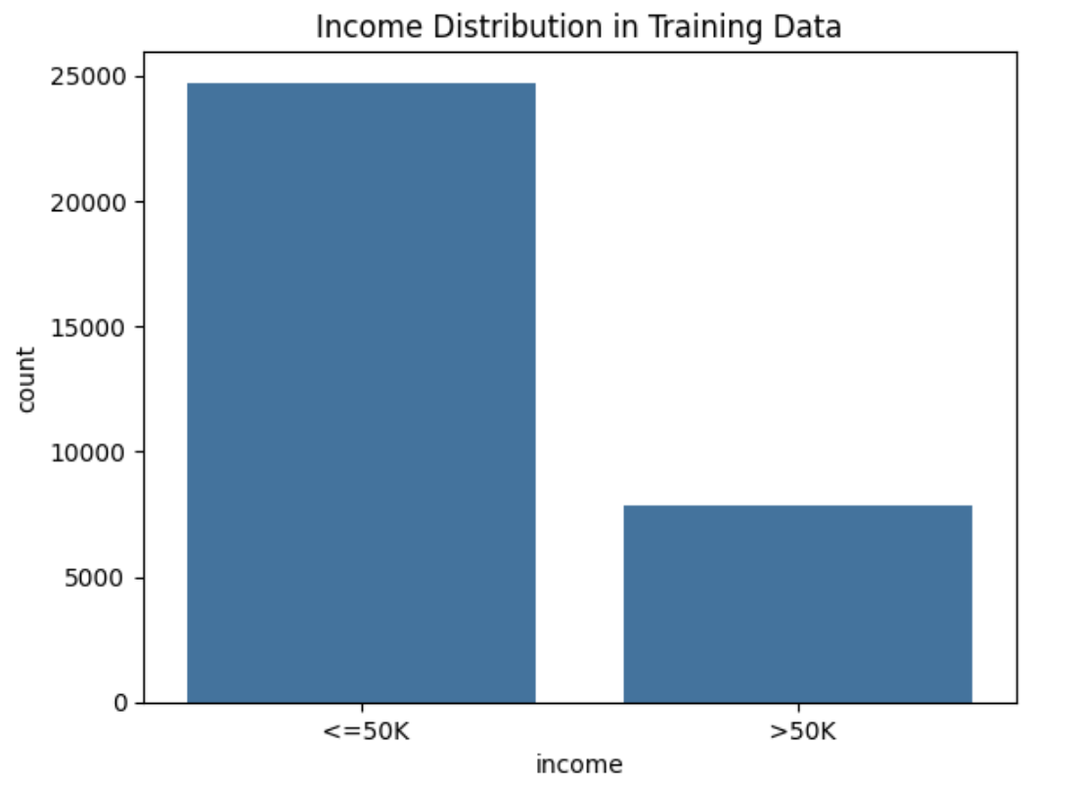
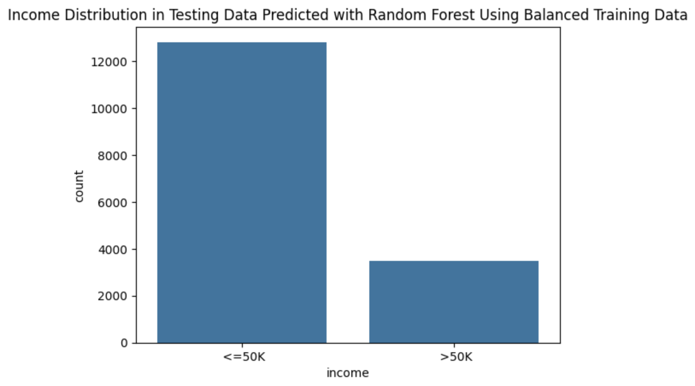
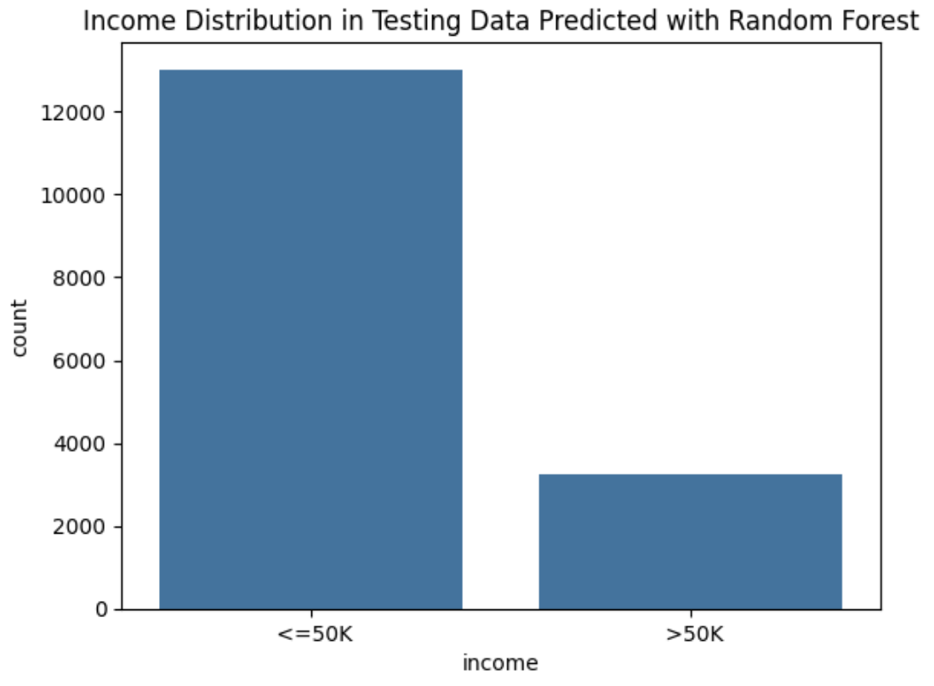
Income Distribution
Rate of <=50K≈ 75.9%
Rate of >50K ≈ 24.1%
Rate of <=50K≈ 78.7%
Rate of >50K ≈ 21.3%
Rate of <=50K≈ 79.9%
Rate of >50K ≈ 20.1%
As expected, there are less people with an income greater than $50,000.
The income distribution predictions of the testing data using Random Forest have a relative distribution and similar proportions to the training data distribution, what is an indicator of model consistency.

Slide 10
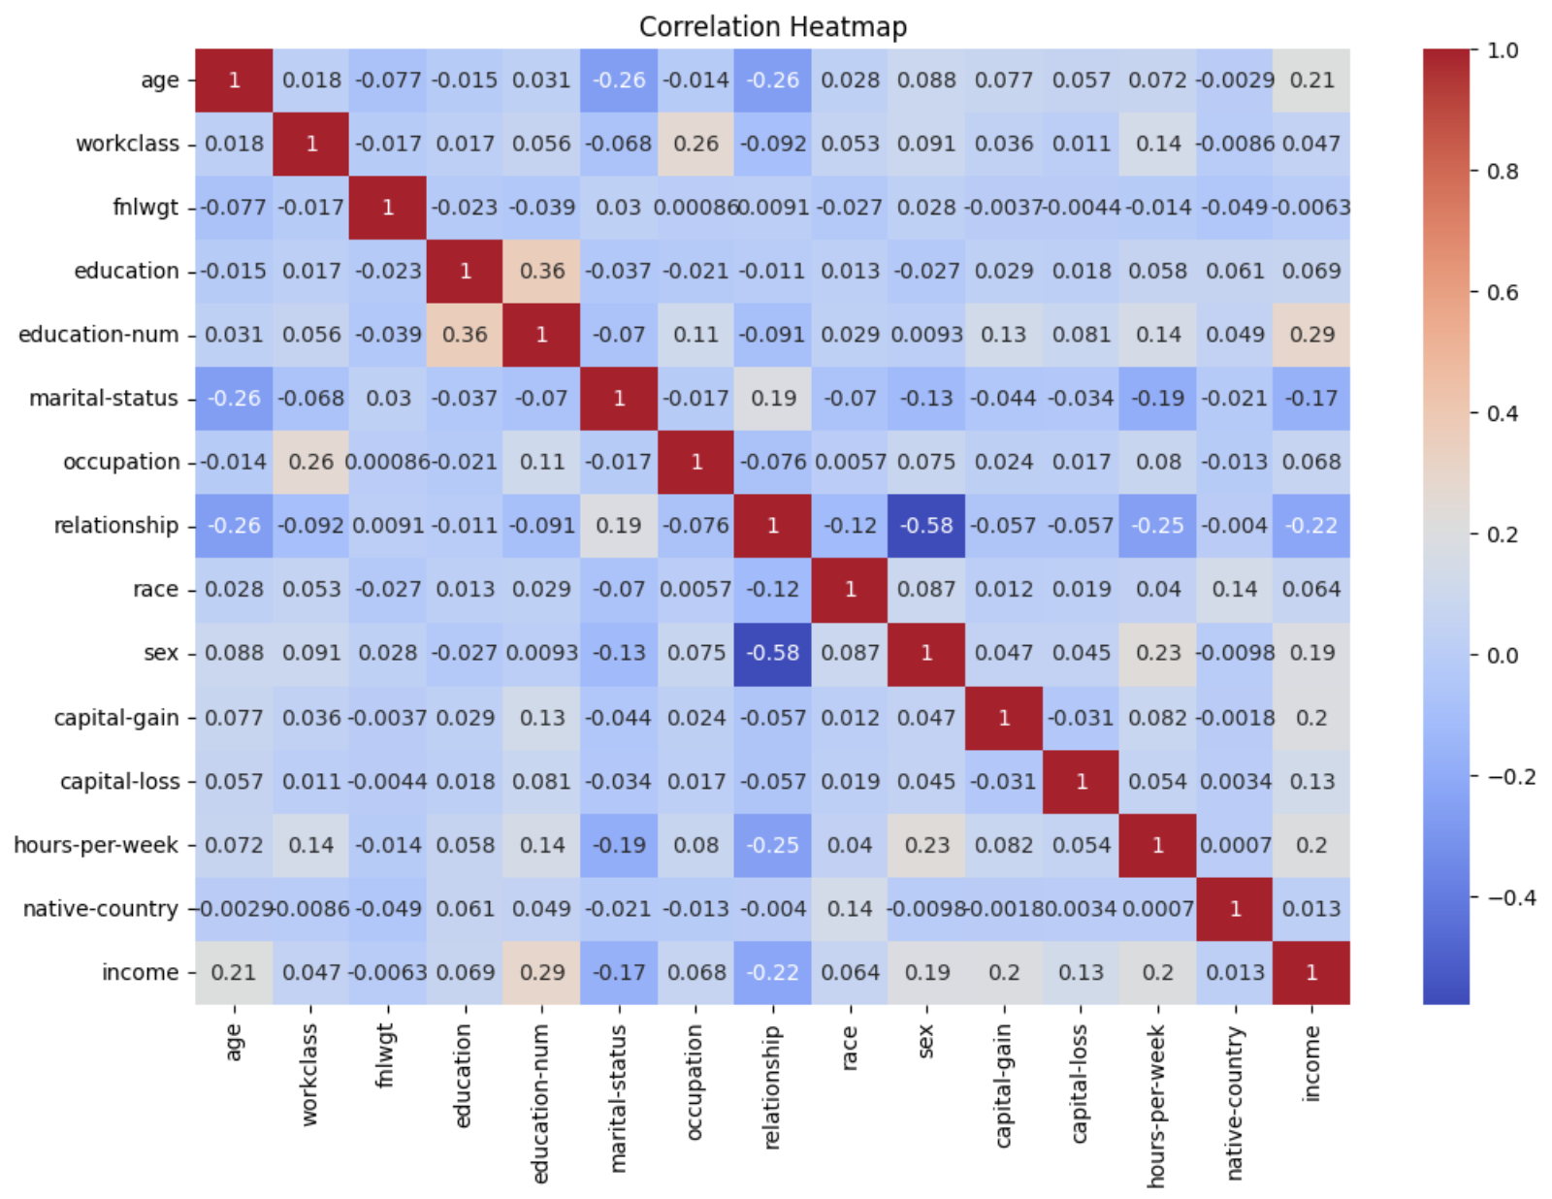
Correlation Heatmap
The correlation analysis between the income column and the remaining columns of the dataset offers the most interesting insights for the purposes of our project.
Income exhibits stronger correlations with 'education-num', 'age', 'sex', 'capital gain', and 'hours per week'.
It negatively correlates with 'marital status' and 'relationship'.

Slide 11
Thanks!
Do you have any questions?
lrosa6@fordham.edu
kal1@fordham.edu
jramos82@fordham.edu
varteagagonzalez@fordham.edu

